Slide 1
Spontaneous Volunteer planning and management
Kathleen Conley, M.Ed., LMHC
Emergency Preparedness Program Coordinator
San Joaquin County Public Health Services
kconley@sjcphs.org
Notes:
Notes
Use the Notes section for delivery notes or to provide additional details for the audience. View these notes in Presentation View during your presentation.
Keep in mind the font size (important for accessibility, visibility, videotaping, and online production)
Coordinated colors
Pay particular attention to the graphs, charts, and text boxes.
Consider that attendees will print in black and white or grayscale. Run a test print to make sure your colors work when printed in pure black and white and grayscale.
Graphics, tables, and graphs
Keep it simple: If possible, use consistent, non-distracting styles and colors.
Label all graphs and tables.

Slide 2
They’re Coming!
We Better Prepare….Now!
    Welcome
    Introductions and Housekeeping
    Pre and post-workshop questionnaires
    Evaluations

Slide 3
Overview
During disasters, large numbers of people unaffiliated with traditional emergency response organizations converge at the scene to offer assistance.
Spontaneous volunteers can be a significant resource, but are often ineffectively used and can actually hinder emergency activities by creating health, safety, and security problems and distracting responders from their duties.

Slide 4
Overview
  The challenge is to capitalize on the outpouring of volunteer resources while ensuring safety and responders’ ability to effectively perform tasks within the established incident command system.
  Systems-based approaches to planning for spontaneous volunteer management in disasters have been developed that are informed by public health practice.

Slide 5
Assumptions
  When disaster strikes a community, trained and affiliated emergency management and nonprofit organizations automatically respond according to pre-established plans.
  Each of these organizations has a specific role to play in ensuring an effective response to, and recovery from, the disaster’s devastation.

Slide 6
Assumptions
  Spontaneous, unaffiliated volunteers – our neighbors and ordinary citizens – often arrive on-site at a disaster ready to help.
  Yet because they are not associated with any part of the existing emergency management response system, their offers of help are often under-utilized and even problematic to professional responders.

Slide 7
        Objectives
        (Participants)
Orient participants to the roles, responsibilities, resources and management of Spontaneous Volunteers in the aftermath of a large-scale emergency or disaster event.
Provide workshop participants with the tools to determine their capacity to recruit, receive, screen, credential, train, deploy, supervise and de-mobilize spontaneous volunteers.
Notes:
I want to help you determine if you can and if you will engage spontaneous volunteers.
Triage – will you do this work?
If not you, who will?
Identify VMS you will use that synchs with your EOPs and operational area volunteer management plans

Slide 8
        Objectives
        (Community Response)
Minimize response and recovery costs to the community.
Minimize disruption to first responders by spontaneous unaffiliated and non-coordinated
affiliated volunteers.
Ensure the safety of volunteers, responders, and the community.
Notes:
I want to help you determine if you can and if you will engage spontaneous volunteers.
Triage – will you do this work?
If not you, who will?
Identify VMS you will use that synchs with your EOPs and operational area volunteer management plans

Slide 9
  What’s the Bridge?
  We want to build our organizational and community capacity, “the bridge,” to prevent, prepare, respond and recover from all-hazards emergencies or disasters.

Slide 10
Decision Matrix
1
2
What do you have in place today?
3
What do you need to plan and exercise to have a robust VMS?
Are volunteers your responsibility?
Notes:
This is another option for a decision slide.

Slide 11
Terminology
Spontaneous Volunteer
Affiliated Volunteer
Unaffiliated Volunteer (SUV)
Volunteer Management System (VMS)
The organizational, operational and integrated methodology to manage volunteers.
Volunteer Reception Center (VRC)
The site/facility where Spontaneous Volunteers will report for screening and deployment.

Slide 12
A Tale of Two Cities
And a Small Town

Slide 13
Case Study – Hampden County Tornadoes EF 3-4
June 1, 2011 Hampden County Tornadoes
EF 3-4, 39 mile path, west to east
1 Hour 10 minutes on the ground
Killed three people, injured 300 people in Springfield alone
500 people homeless in Springfield's MassMutual Center arena. Hundreds of homes destroyed.
More than 48,000 electricity customers lost power.
Over $150 million in damages
2 -3 year recovery
Notes:
Add a case study or class simulation to encourage discussion and apply lessons.

Slide 14
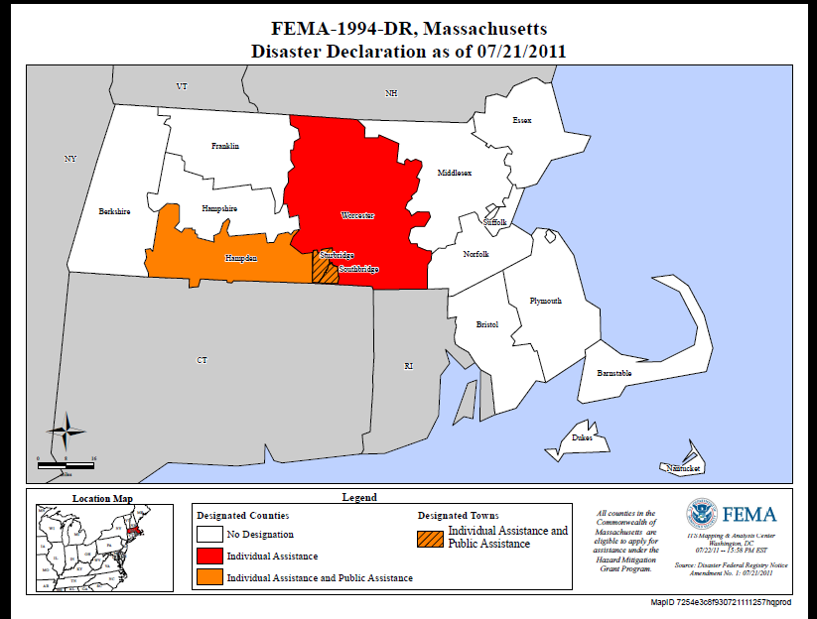
Resources

Slide 15
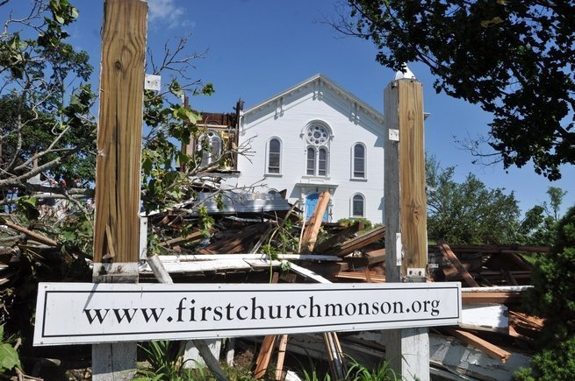
Volunteer Chaos
Notes:
Tell the story of three communities receiving and processing volunteers in very different organic manners. 2-3 year effort.
+
-

Slide 16
Three Communities
Three Responses
No plans for Spontaneous Volunteer Management
Existing volunteer infrastructure included: ARC, MRC, CERT and Salvation Army
What worked? What didn’t work?
AARs and IPs
Notes:
Summarize presentation content by restating the important points from the lessons.
What do you want the audience to remember when they leave your presentation?
Save your presentation to a video for easy distribution (To create a video, click the File tab, and then click Share. Under File Types, click Create a Video.)

Slide 17
Summary
Define your challenges
  Use the pre and post workshop questionnaire as a guide
  Follow the PHEP capabilities
Set realistic expectations
  Assessment, Implementation and Exercising are complex processes.
Keep your eye on the goal
  Building your organizational and community capacity to prevent, prepare, respond and recover from all-hazards emergencies or disasters.
Notes:
Volunteer Management is labor intensive. Volunteer Management without planning is VERY labor intensive.
1. What do you want?
2. What will you do to get it?
3. How will you know if you got there?
Save your presentation to a video for easy distribution (To create a video, click the File tab, and then click Share. Under File Types, click Create a Video.)

Slide 18
Resources
FEMA Spontaneous Volunteer Management
Marin Sheriff Spontaneous Volunteer Management
Volunteer Fairfax VRC Video
Volunteer Video JITT Columbia, Missouri
Western Mass Medical Reserve Corps
wmmrc.org

Slide 19
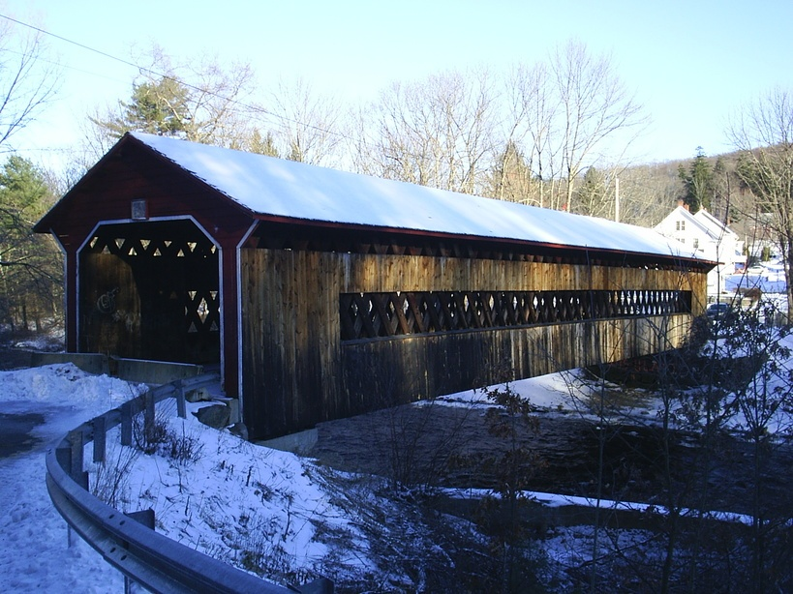
Questions?

Slide 20
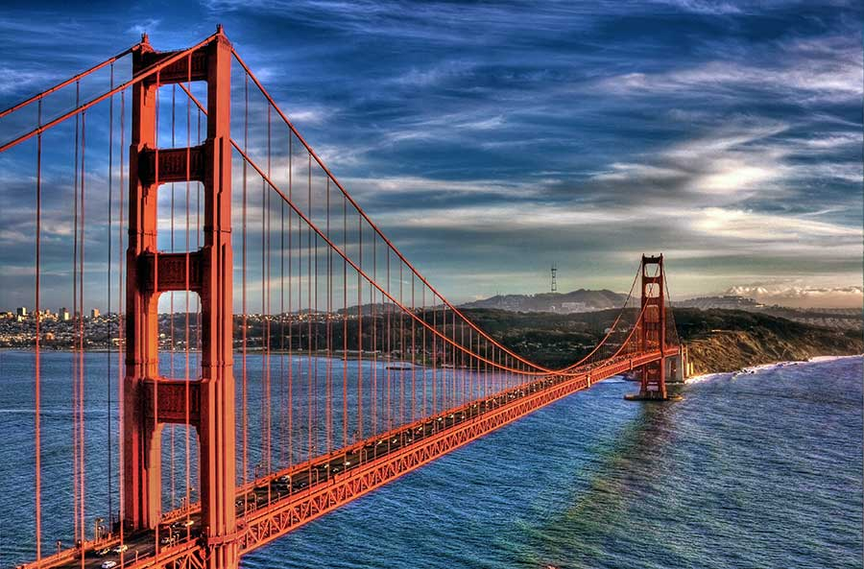
Bridges

Slide 21
Contact Information
  Kathleen Conley, M.Ed., LMHC
  Emergency Preparedness Program Coordinator
  San Joaquin County Public Health Services
  kconley@sjcphs.org
  209 468-9361
Notes:
Discuss outcomes of the case study or class simulation.
Cover best practices.

